Slide 1

CAPSTONE PROJECT FINAL REVIEW Customer Churn Prediction using ANN
Name : Tushar Maurya
Register No:19BCE1856
Programme & Specialization : B.Tech CSE
Guide Name:
Dr. K. Sathyarajasekaran

Slide 2
Outline
Introduction
Background Work, Challenges
Problem Statement
Research Objective
Proposed System
Introduction
Diagram
Modules
Explanation of Modules
Result
Guide Approval mail snapshot
Research Paper Status
References

Slide 3
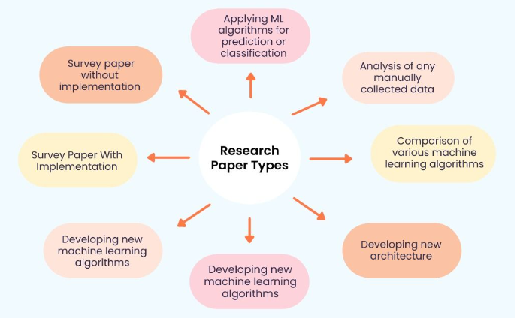

Slide 4
Introduction
Businesses around the world are evolving every day which has drastically led to the growth of two major fields Artificial intelligence and Machine Learning.
Technology based on AI and ML has recently developed to such an extent that it has become an essential element of the largest online stores on the web.
Most of the work in the online store is automized.

Slide 5
Other fields where ML and AI have achieved excellence:-
Speech recognition(Voice search, appliance control, Alexa Home, Google Home)
Virtual Assistant(Alexa, Siri)
Image recognition(facial, non-living things)
Google Translation(Language translation)
Traffic Alerts in Google Maps
Self-driving cars(Waymo)
Medical diagnosis
Predictive analytics(Loan prediction, SIP amount prediction)
Recommender System(Music and movie Recommendations)

Slide 6
Background Work, Challenges
The main work behind the scene is the phase of learning because it’s true that AI and ML are very vast topics.
So every day, I am learning new algorithms and focusing on building better practical models, and learning how to optimize the model in a better way because I felt in most cases the model is already prepared its about the space that is so large or the accuracy that is so bad.
I also faced issues while studying and selecting the correct material for different topics as most of the courses were either highly paid or the courses on youtube aren’t reliable.

Slide 7
The main challenge was selecting the final idea as the field is evolving at its peak because of the tech giants like Amazon, Alibaba, Flipkart, and Walmart.
Every day I read one article in the morning since I enrolled in the capstone project as working on this idea as my final project was one of my dreams when I joined the college due to the placements I was not very regular but still I was able to make ends meet.
The Research paper was not a difficult part as I was getting the idea of how to implement it by reading so much in the right direction.

Slide 8
Problem Statement
I have seen many Research papers and I found that much research work has been done in the field but still there is much more left.
Many companies have a weak working algorithm which sometimes affects their sales and they don’t even exactly know how many customers stopped buying from their website.
So, I have decided to work on the churn Prediction and not only that try including the dataset of other companies so that you don’t make a mistake. It’s true that you learn from your mistake but if others are making mistakes why not learn from them?

Slide 9
Research objectives
My main research objective is to find an ANN solution for the given problem in an optimized manner because I tried to find the Research paper’s Future Work in many of them it was mentioned the Deep Learning approach with Hyperparameter tuning. So, this approach can further lead to an optimized approach in this field.
Companies like Dunnsolution have made the E-commerce world a competitive market as they are specially providing their services in this field to have all sorts of models.
I would also like to see if the ANN could lead to some remarkable or tremendous improvement in the field of Deep Learning.

Slide 10
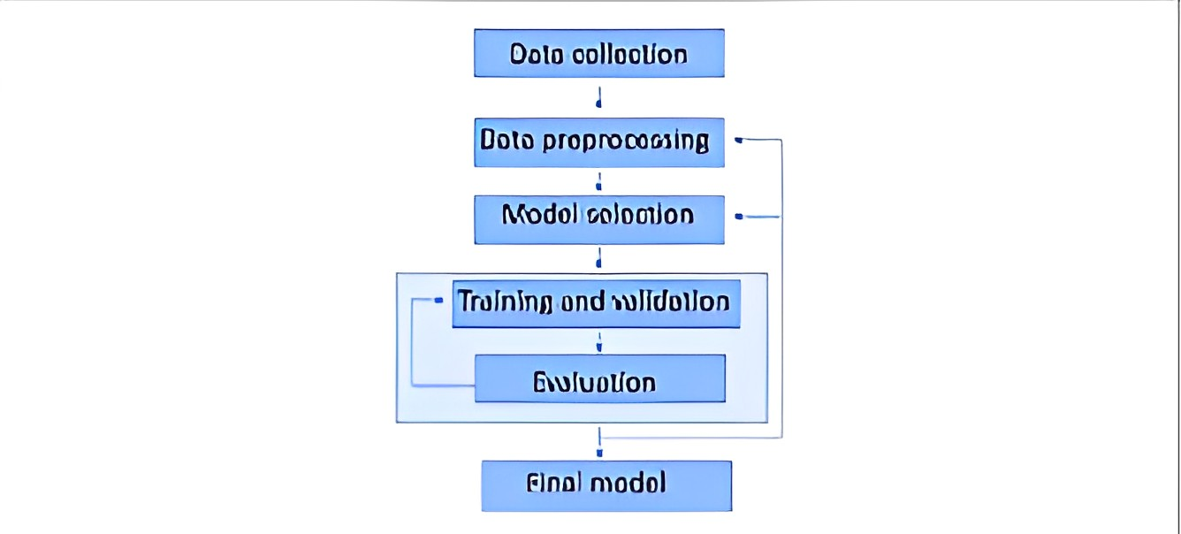
Proposed System
Dataset:
Based on the requirement, the Dataset is to be a tabular dataset stored in a Pandas DataFrame.
The dataset contains 21 columns, with each column representing a different variable or attribute about the customers. The dataset contains 5630 observations (rows).
We will perform EDA and Data cleaning so that we can make it a perfect fit for the ANN model.

Slide 11
Data cleaning, EDA and preprocessing:
The code is performing data cleaning and visualization tasks to gain insights into customer behavior and preferences. The first step is to clean the data by replacing missing values and converting string values into numeric codes. The code is then performing various visualizations, such as histograms, bar charts, and pie charts, to understand the distribution of different variables.
The code is aimed at understanding the factors affecting customer churn for a company. The visualizations help to identify patterns and trends in the data, which can be used to make data-driven decisions in the e-commerce platform. By removing outliers, the code ensures that the visualizations provide an accurate representation of the data.
Overall, the code demonstrates how to use Python to clean and visualize data, which is an essential step in any data analysis project. The insights gained from the visualizations can help businesses to make informed decisions that lead to increased customer satisfaction and retention.
After cleaning and visualizing the data, it performs Min-Max Scaling to ensure that all the variables are on the same scale and calculates the correlations between different variables using a heatmap. The goal of this step is to identify relationships between variables and potentially identify which variables are most strongly correlated with customer churn
Finally, the code splits the data into training and testing sets and builds a predictive model using machine learning algorithms. The goal of the model is to identify customers who are likely to churn, which can help the company retain its customers and reduce the churn rate.

Slide 12
Build and Train Model
A Keras Sequential model using the keras. Sequential() function. The model consists of three layers: a Dense layer with 19 neurons, a Dropout layer, and another Dense layer with one neuron.
The Dense layer is a fully connected layer, where each neuron is connected to every neuron in the previous layer. The input_shape parameter specifies the shape of the input data, which is a one-dimensional array with 19 elements. The activation function used in the Dense layer is relu, which stands for Rectified Linear Unit. It's a popular activation function that introduces non-linearity into the neural network and helps the model learn complex patterns in the data.
The Dropout layer is a regularization technique that randomly drops out (i.e., sets to zero) some of the neurons in the previous layer during training. This helps prevent overfitting, where the model learns to fit the training data too closely and does not generalize well to new, unseen data. The dropout rate is specified as a decimal fraction, in this case 0.1, meaning that 10% of the neurons in the previous layer will be randomly dropped out during training.
The output layer is another Dense layer with one neuron and a sigmoid activation function. The sigmoid function maps any input value to a value between 0 and 1, which can be interpreted as a probability. In this case, the model is being trained to classify binary data, so the output will represent the probability of the input belonging to one of the two classes.

Slide 13
After defining the model, the code compiles it using the compile() function. The optimizer parameter specifies the algorithm used to optimize the model weights during training. In this case, it's the Adam optimizer, which is a popular choice for deep learning models.
The loss parameter specifies the loss function used to evaluate how well the model is performing. In this case, it's binary crossentropy, which is commonly used for binary classification problems.
The metrics parameter specifies additional metrics to track during training. In this case, the model will track accuracy.
Finally, the model is trained using the fit() function, which takes in the training data x_train and y_train, as well as the number of epochs to train for. The model will train for 100 epochs, updating the weights after each batch of training data is processed.
During training, the model will attempt to minimize the loss function by adjusting the weights in the neural network layers. The goal is to find the weights that will make the model perform well on new, unseen data.

Slide 14
Result
Based on the evaluation metrics, it appears that the machine learning model has an accuracy of 0.8811, which means that it correctly predicted 88.11% of the samples in the test set. The confusion matrix and precision scores provide more detailed information about the model's performance on each class.
The confusion matrix shows the number of true positives, false positives, true negatives, and false negatives for each class. It can be visualized using a heatmap, which helps to identify any patterns or imbalances in the model's predictions.

Slide 15
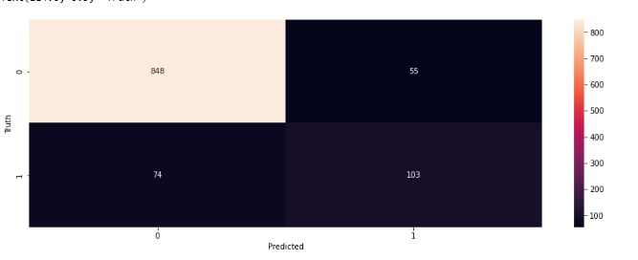
The precision score for class 0 is 0.93, which means that out of all the samples predicted as class 0, 93% were actually class 0. The precision score for class 1 is 0.60, which means that out of all the samples predicted as class 1, 60% were actually class 1.

Slide 16
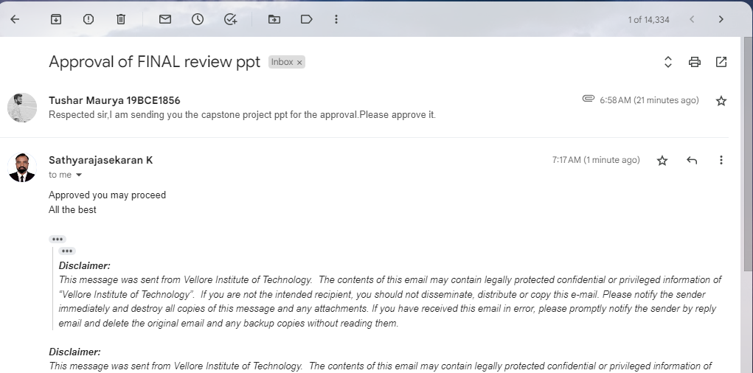
Guide Approval Snapshot

Slide 17
Research Paper Status
I have asked my Guide to publish the Research Paper. So, it’s basically in communication phase.

Slide 18
References ( Same order as Literature Review)
The Impact of Customer Satisfaction and Relationship Quality on Customer Retention: A Critical Reassessment and Model Development [1997]
Thorsten Hennig-Thurau and Alexander Klee (University of Hanover)
Churn Prediction: Does Technology Matter? [2006]
John Hadden, Ashutosh Tiwari, Rajkumar Roy, and Dymitr Ruta
Scikit-learn: Machine Learning in Python [2012]
Fabian Pedregosa, Gaël Varoquaux, Alexandre Gramfort, Vincent Michel, Bertrand Thirion, Olivier Grisel, Mathieu Blondel, Peter Prettenhofer, Ron Weiss, Vincent Dubourg, et al

Slide 19
Customer Churn Prediction in Telecommunication A Decade Review and Classification [2013]
Nabgha Hashmi ,Naveed Anwer Butt and Dr.Muddesar Iqbal
An Integrated Framework to Recommend Personalized Retention Actions to Control B2C E-Commerce Customer Churn [2015]
Shini Renjith
Predicting Shipping Time with Machine Learning. [2015]
Antoine Jonquais, Florian Krempl Advisor, Dr. Roar Adland, Dr. Haiying Jia
LightGBM: A Highly Efficient Gradient Boosting Decision Tree [2017]
Guolin Ke , Qi Meng , Thomas Finley , Taifeng Wang , Wei Chen , Weidong Ma , Qiwei Ye , Tie-Yan Liu

Slide 20
Customer Lifetime Value Prediction Using Embeddings [2017]
Benjamin Paul Chamberlain, Angelo Cardoso, C.H. Bryan Liu, Roberto Pagliari, Marc Peter Deisenroth
Introduction to artificial neural networks [2018]
Enzo Grossi , Massimo Buscema
Online Fashion Commerce: Modelling Customer Promise Date [2021]
Preethi V, Nachiappan Sundaram, Ravindra Babu Tallamraju

Slide 21
Thank You

